Slide 1
Azure Functions
March 28, 2019 — 8:30 AM - 5:00 PM | Detroit, Michigan
Learn, architect, and develop solutions on Azure
#AzureDevDays
for developers, by developers
Learn.
Connect.
Explore.

Slide 2



Serverless in Azure
Functions
Logic Apps
Event Grid
Serverless compute
Serverless workflow
Serverless events
Notes:
Serverless is the natural evolution in the trend of abstracting anything not related to app code
We looked at the characteristics and benefits of serverless services.
Azure we have three key services for serverless apps: functions, logic apps and event grid
Now we are going to be looking at Azure Functions and in the next session we will cover Event Grids.

Slide 3
What is an Azure Function?
Typically a small, precise and
highly cohesive unit of code that
can be triggered to run
based on an event
or schedule.
Notes:
So what is an Azure Function?
In a nutshell is it a unit of code that can run based on a trigger, which is either an external event or based on regular schedule. An external event could be a message in a queue, or event hub or even an HTTP call. Alternatively, Azure functions can be configured to run on a schedule. Both of raised events or schedules are referred as Azure Function triggers, either time based trigger or event trigger.

Slide 4






Apps
eCommerce
Digital Global Presence
Custom Apps
LOB
API / Services / ISV
App Service
Web Apps
API Apps
Mobile Apps
Functions
Logic Apps
Fully Managed Platform
Development
Enterprise Grade
Limitless/Auto
OS and Framework
Load balance
Languages and Framework
Superior DevOps
Self served
Enterprise grade SLA
Secure and Compliance
On-Premise Connectivity

Slide 5

Introducing Azure Functions
Process payment
Checkout cart
Fix exposure
Upload photo
Find map location
Send GPS coordinates
Notes:
Examples of events can be anything from a user checking out a shopping cart on a website to processing a photo uploaded from a phone to reacting to a message from a connected car.
Using functions you can write just the code you need for the problem at hand, without worrying about the complexity of a whole application or the infrastructure to run it.

Slide 6
Triggers
Triggers
HTTP request
Process payment
Checkout cart
Blob Storage
Fix exposure
Upload photo
Event Hub
Find map location
Send GPS coordinates
Notes:
Functions are “triggered” when an event occurs and they support a number of triggers that your code can respond to.
For example:
HttpTrigger allows you to respond to HTTP requests.
BlobTrigger for responding to files uploaded to Blob Storage.
EventHubTrigger to respond to incoming Event Hub messages.
Since a trigger is how a function starts each function has one and only one trigger.

Slide 7
Bindings
Triggers
Input Bindings
HTTP request
Cart contents
Process payment
Checkout cart
Blob Storage
Photo file path
Fix exposure
Upload photo
Event Hub
Coordinates
Update map location
Send GPS coordinates
Notes:
Triggers have associated data (e.g. the path of the file uploaded to blog storage).
This data can be accessed from your function code declaratively using bindings.
Bindings make it possible to access the data and resources that triggered your function without hardcoding values.
There are two types of bindings: input and output.
Input bindings allows you to read data from the resource that triggered your function like the file location in blob storage or the message from an event hub.
Output bindings allow you to write to resources using your function like storing a new file in blob storage or adding a new message to the event hub.

Slide 8
Output Bindings
Triggers
Input Bindings
Output Bindings
HTTP request
Cart contents
Send HTTP 200 success
Checkout cart
Process payment
Blob Storage
Photo file path
Save updated file
Upload photo
Fix exposure
Event Hub
Coordinates
Send message to map app
Send GPS coordinates
Update map location
Notes:
Triggers have associated data (e.g. the path of the file uploaded to blog storage).
This data can be accessed from your function code declaratively using bindings.
Bindings make it possible to access the data and resources that triggered your function without hardcoding values.
There are two types of bindings: input and output.
Input bindings allows you to read data from the resource that triggered your function like the file location in blob storage or the message from an event hub.
Output bindings allow you to write to the resource that triggered your function like storing a new file in blob storage or adding a new message to the event hub.

Slide 9
Azure Functions Architecture
Functions
Runtime
Functions Programming Interface
Input Bindings
Triggers
Output Bindings
App Service
App Hosting Plans

Slide 10
Hello Azure Functions World! (Web)
Files comprising a C# function…
function.json
run.csx
Bindings
Code
Defines input and output bindings.
Code that runs in response to the trigger.
Notes:
Each function consists of two files:
a bindings file containing the input and output bindings in JSON format
a code file containing the function business logic in the language chosen, C# in this case
Let’s take a closer look at the bindings file…

Slide 11
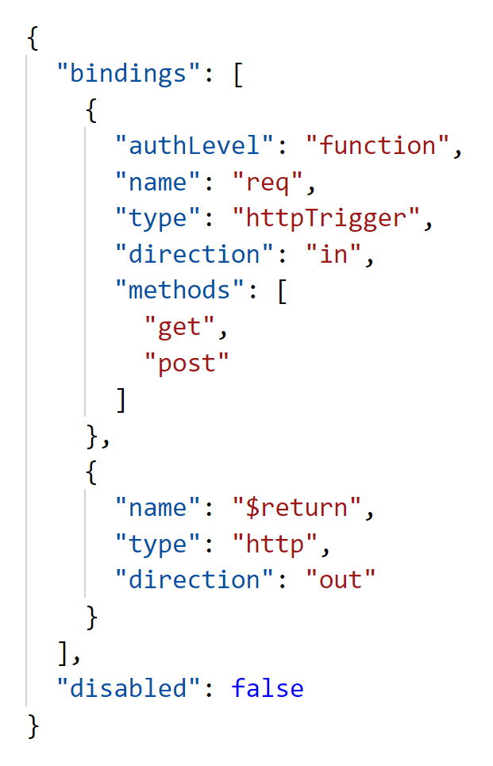
Bindings defined in function.json
Name of the binding to use in code
Type of trigger
Sets it as an input binding
Sets it as an output binding

Slide 12
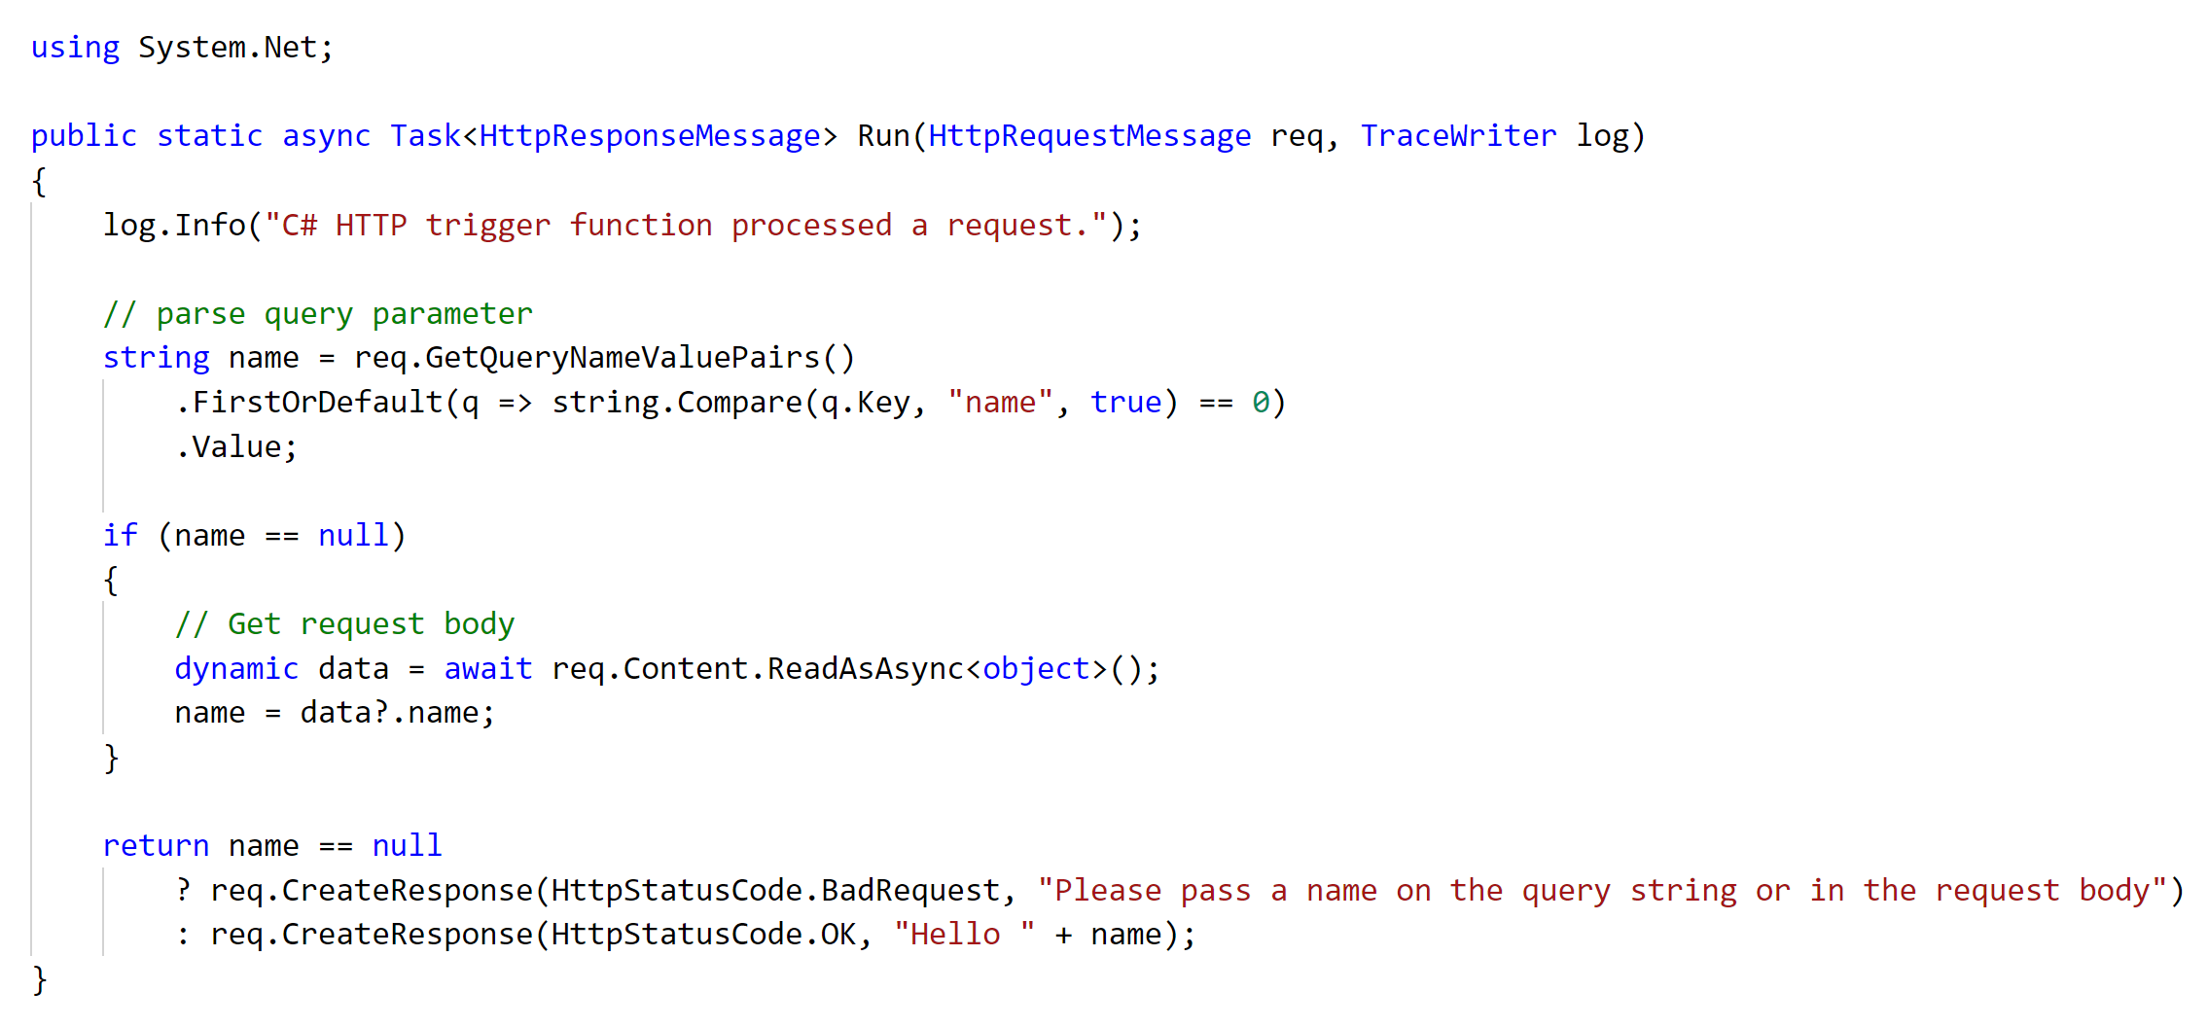
Function code in run.csx
Read from input binding
Read from input binding
Write to output binding
Notes:
Here is our simple function in C#
This function implements an HttpTrigger so it responds to an HTTP request.
It uses and input binding to get the name passed on the query string of the HTTP request.
And then writes the name to Azure Storage using the output binding

Slide 13
Introducing Azure Functions 2.0

Slide 14










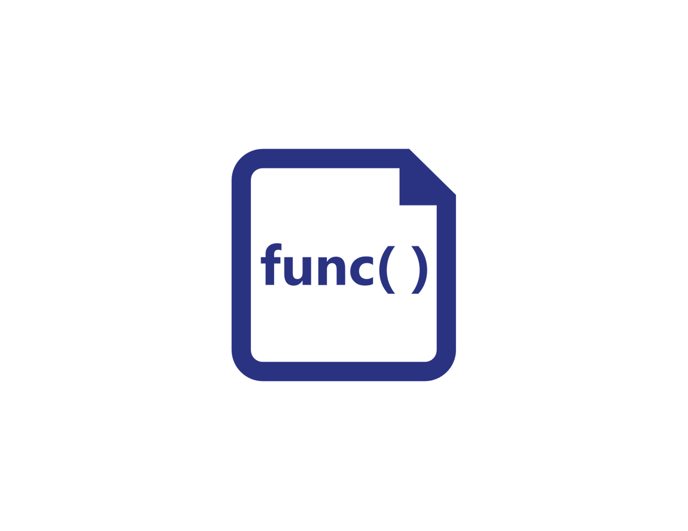




Functions everywhere
https://github.com/azure/azure-functions-host
(+other repos)
Azure Functions host runtime
Azure Functions Core Tools
Azure Functions base Docker image
Azure Functions .NET Docker image
Azure Functions Node Docker image
●●●
Development
Hosting
Local dev machine
Azure Functions
service
Azure Functions service
IoT devices
Additional Azure hosts
Non-Azure hosts
On-premises
Platform
+
●●●
●●●
●●●
Core Tools + favorite editor
Consumption plan
App Service plan
Azure IoT Edge
AKS, Service Fabric Mesh, …
K8s, raw VMs, & more
App Service on Azure Stack
Application delivery
Code or container
Code
Code or container
Container
Container
Container
Code
Operating system
Windows, macOS, or Linux
Windows or Linux
Windows or Linux
Linux
Linux
Linux
Windows

Slide 15



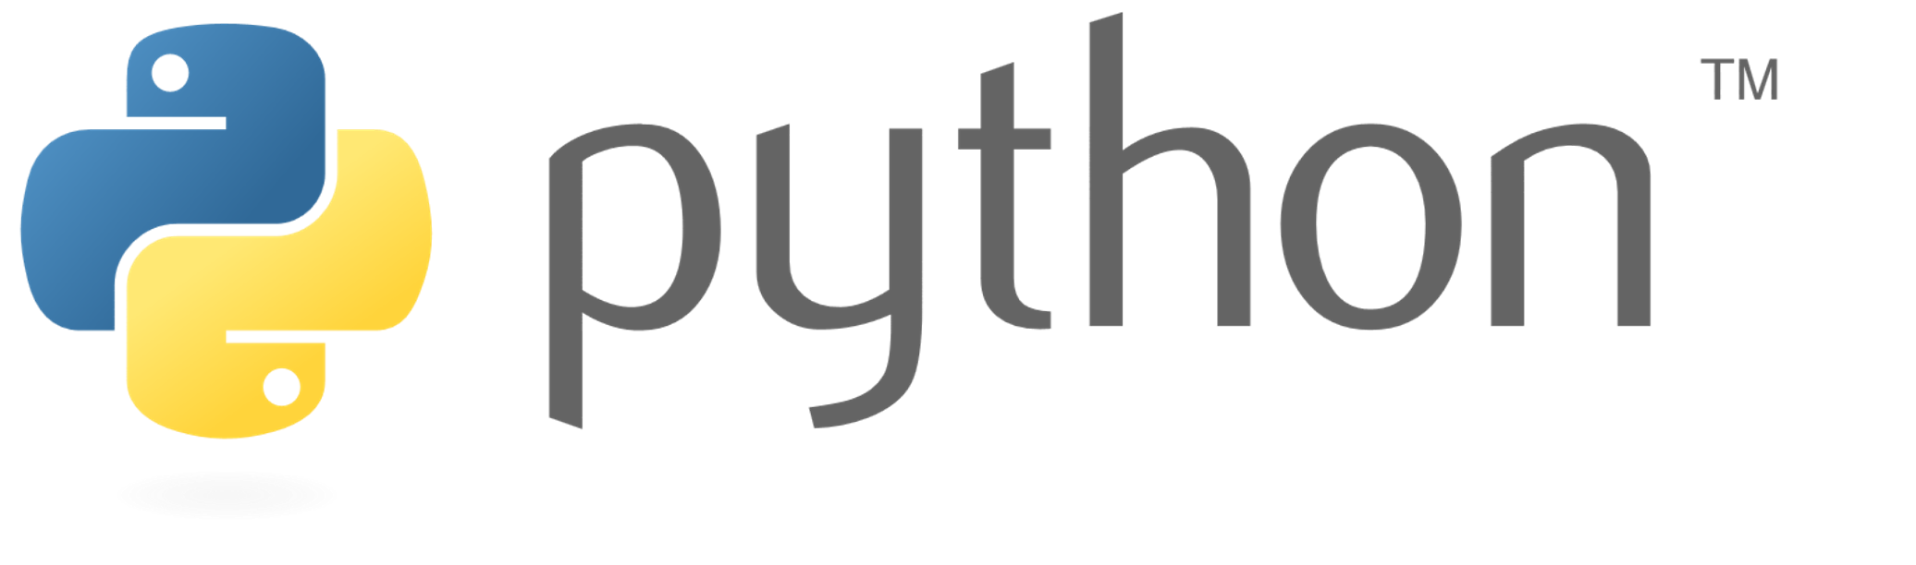
Language options
Generally available
Public preview
Public preview
New!
More on the way!

Slide 16
Bindings and integrations
Functions 1.0
Microsoft.NET.Sdk.Functions (.NET Framework 4.6)
HTTP
Timer
Storage
Service Bus
EventHubs
Cosmos DB
Functions 2.0
Microsoft.NET.Sdk.Functions (.NET Standard 2.0)
HTTP
Timer
Microsoft.Azure.WebJobs.Extensions.Storage 3.0.0
Microsoft.Azure.WebJobs.Extensions.ServiceBus 3.0.0
Microsoft.Azure.Webjobs.Extensions.EventHubs 3.0.0
Microsoft.Azure.WebJobs.Extensions.CosmosDB 3.0.0
Microsoft.Azure.Webjobs.Extensions.EventGrid 2.0.0
Microsoft.Azure.WebJobs.Extensions.DurableTask 1.4.0
Microsoft.Azure.Webjobs.Extensions.MicrosoftGraph 1.0.0-beta

Slide 17


Durable Functions
var outputs = new List<string>();
outputs.Add(await context.CallActivityAsync<string>("SayHello", "BRK3348"));
return outputs;
History Table
Orchestrator Function
Orchestrator Function
Activity Function
Orchestrator Started
Activity Function
Execution Started
Task Scheduled, SayHello, "BRK3348"
Orchestrator Completed
["Hello BRK3348!"]
"Hello BRK3348!"
"Hello BRK3348!"
Task Completed, "Hello BRK3348!"
?
Orchestrator Started
Execution Completed, ["Hello BRK3348!"]
Orchestrator Completed
Execution History
Notes:
Durable Functions is an extension of Azure Functions and Azure WebJobs that lets you write stateful functions in a serverless environment. The extension manages state, checkpoints, and restarts for you.
Orchestrating Functions & Activity Functions
Now you can programmatically dispatch functions and start chaining them together without setting up queues.
Durable Functions are reliable and has fault tolerance built in.
Orchestrating Functions: Has built in state and checkpointing, allowing the function to run for a long time, as long as you need.

Slide 18
DevOps and Serverless

Slide 19
Inner and Outer Loop Development
Outer Loop
Build and Test (CI)
Deploy
(CD)
Run
(Prod)
Inner Loop
Source Control
Monitoring and Diagnostics
Code
Run
Debug

Slide 20
Available tools of Azure Functions
Local Tools
Deployment Center (Kudu)
Azure DevOps
Other CI/CD
Quickly publish to production
Best Suited – Quickly validate code works in the cloud
Watch out – “Friends don’t let friend right-click publish”
Tip – Use the ‘run from package’ feature
App Services powered CI/CD
Best Suited – One-click deploy from GitHub/source
Watch out – Not as customizable as Azure DevOps pipelines
Tip – Use the new “Deployment Center” section
Fully managed CI/CD
Best Suited – Production CI/CD with various environments
Watch out – Web Deploy vs Run from Package
Tip – Can call functions as release gates
Any other CI/CD tool (Jenkins, Octopus, Travis)
Best Suited – Integrated serverless with existing tools and processes
Watch out – Documentation and samples are limited
Tip – Use the ‘run from package’ publish gesture

Slide 21
Inner Loop Best Practices
Write unit tests for your functions
How should this behave on success?
How should this behave on failure?
Mock external systems and side-effects
Environment variables == local.settings.json == Application Settings
local.settings.json when local
Application Settings when published

Slide 22
Outer Loop Best Practices
Every function should be checked into source control
Feature / Bug branches should be tested before merge into master
Code compiles
Unit tests pass
Deploy to stages
Development, Pre-Prod, Prod
Use release gates and approval (auto or manual) between stages
Use slots where appropriate
Optimized today for HTTP scenarios
Be aware of scaling impacts to consumption functions
Enable Application Insights

Slide 23

Monitoring
Gain real-time observability
Analyze and debug traces and metrics
View dependencies and relationships with AppMap
Application Insights

Slide 24
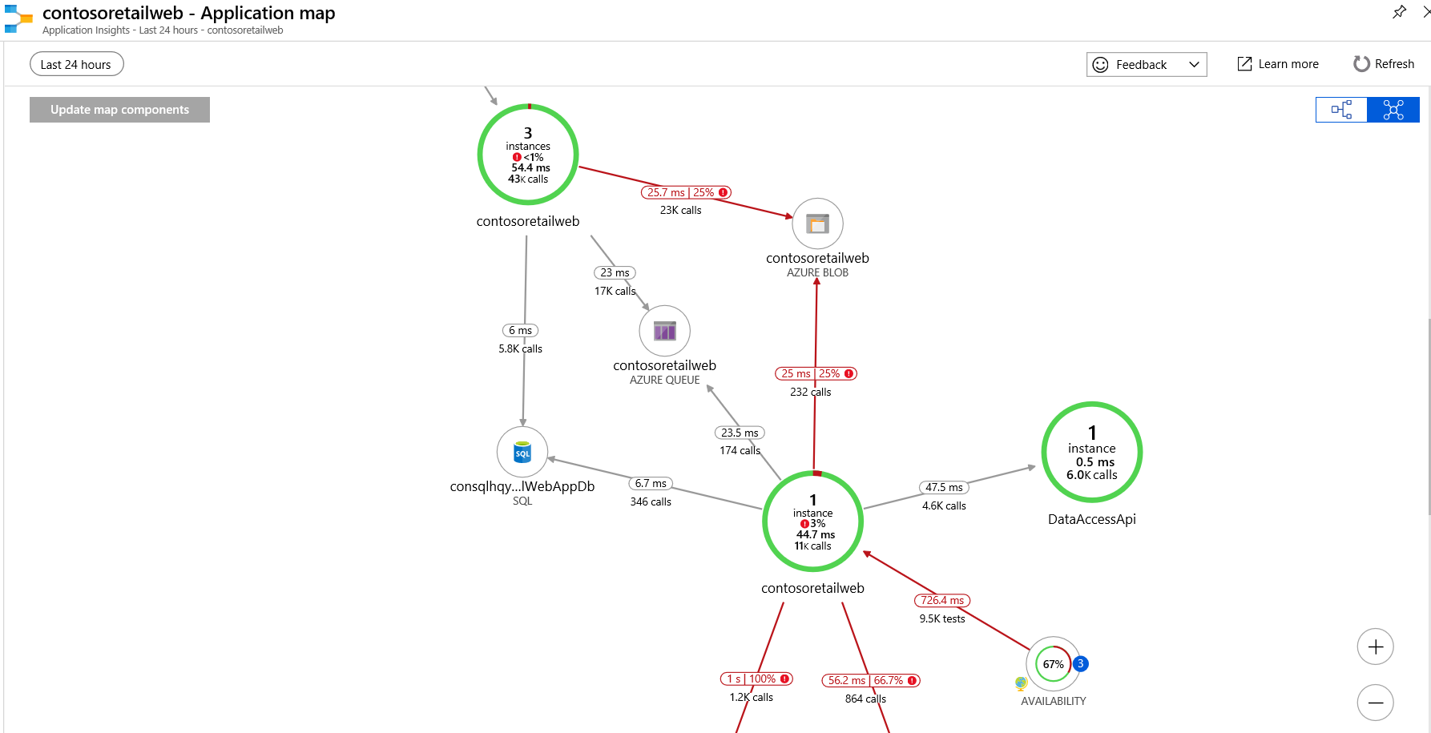

Slide 25
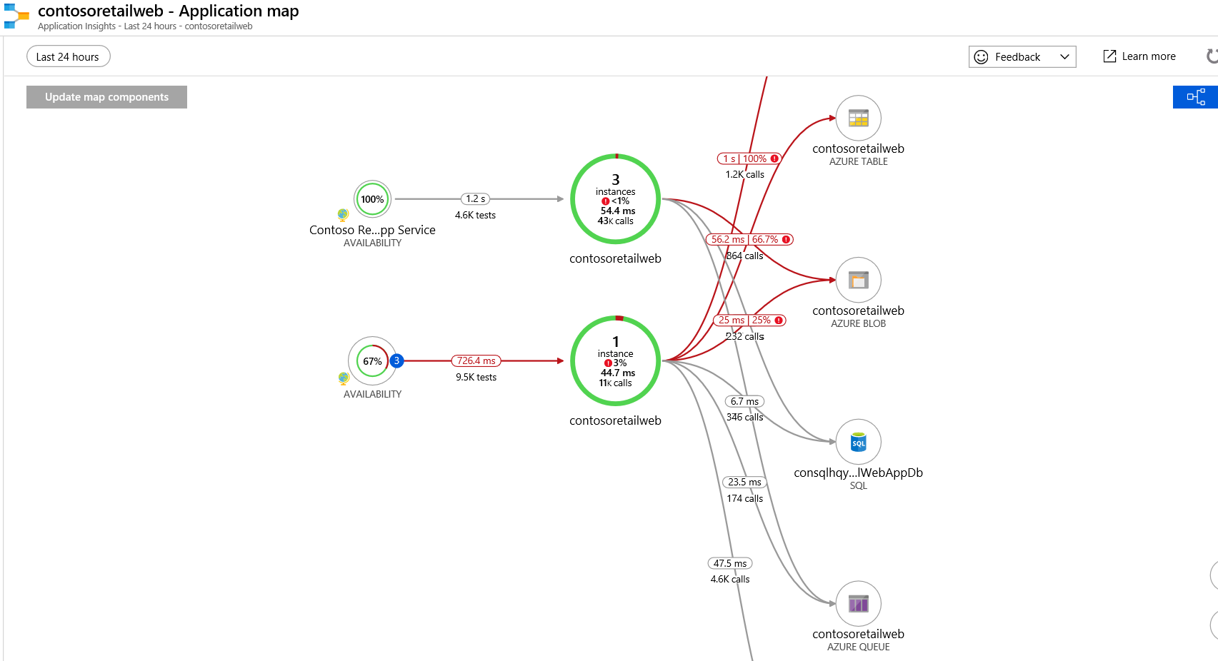
Application Map

Slide 26
Azure Functions Demo
Portal
Visual Studio Code
Visual Studio
Azure DevOps

Slide 27
Serverless Security

Slide 28
The shared responsibility model
Physical security
Host infrastructure
Operating system
Network controls
Identity & access management
Logical application server
Application logic
Client endpoints
Data classification
On-prem
IaaS
PaaS
Serverless
SaaS
Cloud provider
Cloud customer

Slide 29
Spot the vulnerability!
module.exports = function (context, payload) {
if (payload.action != "opened") {
context.done();
return;
}
var comment = { "body": "Thank you for your contribution! We will get to it shortly." };
if (payload.pull_request) {
var pr = payload.pull_request;
context.log(pr.user.login, " submitted PR#", pr.number, ": ", pr.title);
SendGitHubRequest(pr.comments_url, comment, context); // posting a comment
}
context.done();
};
function SendGitHubRequest(url, requestBody, context) {
var request = require('request');
var githubCred = 'Basic ' + 'mattchenderson:8e254ed4';
request({
url: url,
method: 'POST',
headers: {
'User-Agent': 'mattchenderson',
'Authorization': githubCred
},
json: requestBody
}, function (error, response, body) {
if (error) {
context.log(error);
} else {
context.log(response.statusCode, body);
}
});
}

Slide 30




Secrets management
const msRestAzure = require('ms-rest-azure');
const KeyVault = require('azure-keyvault');
const vaultUri = process.env['GITHUB_SECRET_URI'];
// Value looks like: 'https://foo.vault.azure.net/secrets/gh’
//... Getting the event
let kvToken = msRestAzure.loginWithAppServiceMSI({
resource: 'https://vault.azure.net'
});
let keyVaultClient = new KeyVault.KeyVaultClient(kvToken);
keyVaultClient.getSecret(vaultUri).then(function (secret){
var githubHeader = 'Basic ' + secret;
//... Call GitHub
});

Slide 31
Coming soon: Key Vault references
@Microsoft.KeyVault(SecretUri=https://myvault.vault.azure.net/secrets/mysecret/mysecretversion)
Gets secrets out of App Settings and into secrets management
Leverages the managed identity of your function app
Versions will be required at initial preview (goal of auto-rotation)
Site runtime
Application settings
Environment vars
Foo: mysecret
Foo: mysecret
Code
Site runtime
Application settings
Environment vars
Foo: reference
Foo: mysecret
Key Vault
Code
Foo: mysecret

Slide 32
Managed identities for Azure Functions
Keep credentials out of code
Auto-managed identity in Azure AD for Azure resource
Use local token endpoint to get access tokens from Azure AD
Direct authentication with services, or retrieve creds from Azure Key Vault
Azure Functions
Azure Service
(e.g., ARM, Key Vault)
Your code
3
1
Local token service
2
Credentials
Azure (inject and roll credentials)

Slide 33


Grouping and permissions
Function app 1
Functions
Configuration
Reader function A
Permission to read
●●●
Writer function B
Permission to write
Writer function C
Repo 1
Function app 2
Repo 2
Functions
Configuration
Writer function B
Permission to write
Writer function C

Slide 34










Spot the vulnerability!
Power BI dashboard
Stream analytics
Recent characteristics table
Calculate characteristics
Send Event
Devices
IoT hub
Snapshots
Uncompress, format, and clean data
Clean data
HDInsight
Characteristics and defects table
ML model
Defect input form
Web app

Slide 35
Spot the vulnerability!
module.exports = function (context, req) {
if (req.body && req.body.name)) {
context.res = {
status: 202
};
context.bindings.outQueueMessage = {
action: "delete",
target: req.body.name
};
}
else {
context.res = {
status: 400,
body: "Please pass a name in the request body"
};
}
context.done();
};

Slide 36
Meanwhile, downstream…
var Connection = require('tedious').Connection;
var config = {
//... Get from env vars
};
var connection = new Connection(config);
connection.on('connect', function(err) {
console.log("Connected");
});
//...
module.exports = function (context, myQueueItem) {
if (myQueueItem.action === "delete") {
let request = new Request("DELETE FROM Inventory WHERE ItemName='" + myQueueItem.target + "';", function(err) {
if (err) {
console.log(err);}
});
connection.execSql(request);
}
context.done();
};

Slide 37





Inputs AND outputs
Am I validating inputs and preventing injection attacks?
Am I validating outputs?
Sanitization
Am I applying proper authorization checks?
Am I granting proper roles and permissions? Am I enforcing least privilege?
T
T
Permissions
Can my app scale well in response to new events?
Can my downstream resources keep up with my scale?
Scalability

Slide 38




When scaling goes wrong
?

Slide 39
Serverless security best practices
Standard PaaS / web app security is still a must-have
New security tooling options needed
More secrets, more secret management
Permissions and grouping – remember least privilege
Mind both inputs and outputs – the app is only as secure as its weakest link
Networking solutions need development, but…

Slide 40
Hosting and Connectivity

Slide 41
Functions hosting options
Development
Hosting
Local dev machine
Azure Functions
service
Azure Functions service
IoT devices
Additional Azure hosts
Non-Azure hosts
On-premises
Platform
+
●●●
●●●
●●●
Core Tools + favorite editor
Consumption plan
App Service plan
Azure IoT Edge
AKS, Service Fabric Mesh, …
K8s, raw VMs, & more
App Service on Azure Stack
Application delivery
Code or container
Code
Code or container
Container
Container
Container
Code
Operating system
Windows, macOS, or Linux
Windows or Linux
Windows or Linux
Linux
Linux
Linux
Windows

Slide 42
Azure Functions Hosting Options
Consumption
Rapid scale out
”Unbounded” scale out
No VNet connectivity available
10 minute execution
Small instance size
Scale to zero
App Service Plan / Environment
Auto-scale out (~5 min)
Fixed scale out(Max=10 nodes)
VNet connectivity / hybrid
Unlimited execution duration
Premium instance size
Always on

Slide 43
Azure Functions Hosting Options
PRIVATE PREVIEW
Consumption
Rapid scale out
”Unbounded” scale out
No VNet connectivity available
10 minute execution
Small instance size
Scale to zero (cold start)
Functions premium plan
Rapid scale out
“Unbounded” scale out
VNet connectivity / hybrid
Unlimited execution duration
Premium instance size
Always on

Slide 44
Azure Functions Demo

Slide 45

Review
Notes:
So in this module we talked about:
Serverless is the natural evolution in the trend of abstracting anything not related to app code
We looked at the characteristics and benefits of serverless services.
Azure we have three key services for serverless apps: functions, logic apps and event grid

Slide 46
Takeaways and next actions
Functions 2.0 – greater flexibility and control
Go create your first 2.0 function!
Sign up for the Python private preview: <<>>
DevOps – keep both inner loop and outer loop in mind
Deployment Center and Azure DevOps are powerful tools!
Test samples: https://github.com/jeffhollan/functions-test-samples
Security in serverless – familiar issues, but at different scale
Key Vault App Settings coming soon
Premium Functions – networking, reserved instances, & more
Sign up for the private preview: http://aka.ms/functionspremium

